Slide 1

C♯ Data Access and Entity Framework Core
Rasmus Lystrøm
Associate Professor
ITU
This Photo by Unknown Author is licensed under CC BY-NC

Slide 2
Agenda
Databases (SQL Server)
Secrets
Old school SQL
SQL Injection
The IDisposable interface
Entity Framework Core
Lazy vs. Eager Loading

Slide 3

Databases

Slide 4
Databases
Relational (SQL)
Microsoft SQL Server
Oracle Database
IBM Db2
MySQL
MariaDB
PostgreSQL
SQLite
Document (NoSQL)
Azure Cosmos DB
Amazon DynamoDB
MongoDB
Couchbase
Redis
Elasticsearch

Slide 5
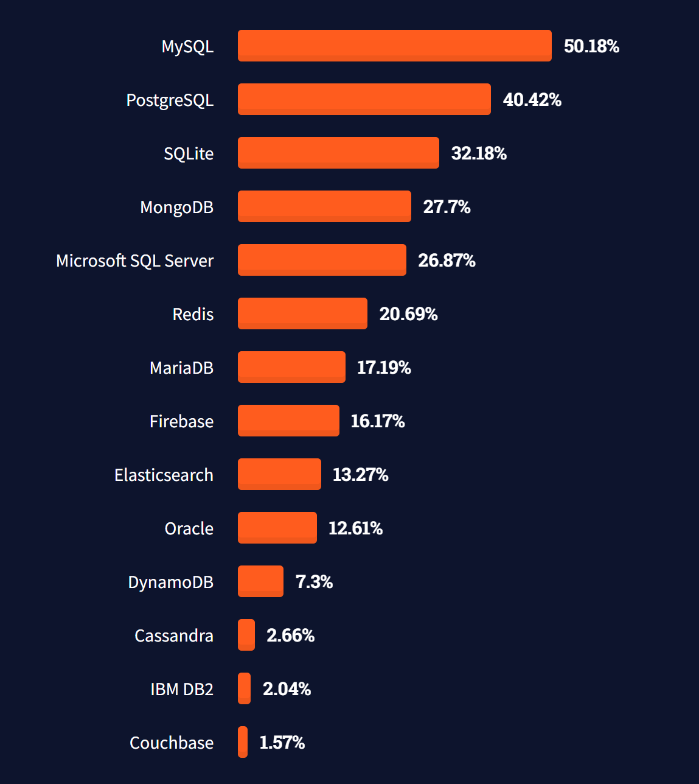
Most popular databases
https://insights.stackoverflow.com/survey/2021#technology-most-popular-technologies

Slide 6
SQL Server
Windows only: SQL Server Express LocalDB
https://docs.microsoft.com/en-us/sql/database-engine/configure-windows/sql-server-express-localdb
All (prefered): SQL Server in a container
Get docker:
https://docs.docker.com/get-docker/
Run container:
https://docs.microsoft.com/en-us/sql/linux/quickstart-install-connect-docker

Slide 7
SQL Server
docker pull mcr.microsoft.com/mssql/server:2019-latest
$password = New-Guid
docker run -e "ACCEPT_EULA=Y" -e "SA_PASSWORD=$password" `
-p 1433:1433 `
-d mcr.microsoft.com/mssql/server:2019-latest

Slide 8
SQL Server Demo
SQL Server Docker Container

Slide 9

Secrets

Slide 10
Secrets
dotnet user-secrets init
dotnet user-secrets set "ConnectionStrings:ConnectionString" "..."
dotnet add package Microsoft.Extensions.Configuration.UserSecrets

Slide 11
Secrets
using Microsoft.Extensions.Configuration;
...
var configuration = new ConfigurationBuilder()
.AddUserSecrets(typeof(Program).Assembly)
.Build();
var connectionString = configuration.GetConnectionString("ConnectionString");

Slide 12
Old School SQL

Slide 13
Old School SQL
dotnet add package System.Data.SqlClient
var cmdText = "SELECT * FROM Animals";
using var connection = new SqlConnection(connectionString);
connection.Open();
using var command = new SqlCommand(cmdText, connection);
using var reader = command.ExecuteReader();
while (reader.Read())
{
...
}

Slide 14
SQL Injection

Slide 15
SQL Injection
A SQL injection attack consists of insertion or “injection” of a SQL query via the input data from the client to the application.
A successful SQL injection exploit can:
read sensitive data from the database,
modify database data (Insert/Update/Delete),
execute administration operations on the database (such as shutdown the DBMS),
or worse
https://owasp.org/www-community/attacks/SQL_Injection

Slide 16
IDisposable

Slide 17
IDisposable
var resource = new Resource();
try
{
...
}
finally
{
resource.Dispose();
}

Slide 18
IDisposable
using (var resource = new Resource())
{
...
}

Slide 19
IDisposable
using var resource = new Resource();
...

Slide 20
Entity Framework Core

Slide 21
Entity Framework Core
dotnet tool install --global dotnet-ef
dotnet add package Microsoft.EntityFrameworkCore.Design
dotnet ef migrations add InitialCreate
dotnet ef database update
https://docs.microsoft.com/en-us/ef/core/miscellaneous/cli/dotnet

Slide 22
Lazy Loading
https://docs.microsoft.com/en-us/ef/core/querying/related-data/lazy

Slide 23
Lazy Loading
dotnet add package Microsoft.EntityFrameworkCore.Proxies
protected override void OnConfiguring(DbContextOptionsBuilder optionsBuilder)
=> optionsBuilder.UseLazyLoadingProxies()
.UseSqlServer(...);
https://docs.microsoft.com/en-us/ef/core/querying/related-data/

Slide 24

Thank you
This Photo by Unknown Author is licensed under CC BY-NC-ND

